Slide 1


DESIGN 1
Lesson 3: Independent Application: The F1 Fan Survey Page
Ms. Abboud • Grade 9 - Design 1 • Term 1, Week 9

Slide 2
Learning Objectives
WALT - We Are Learning To
WILF - What I'm Looking For
Build a Fan Survey page with new input types.
Add the new page to the menu on every page.
The survey uses radio buttons, checkboxes and a dropdown, each labelled.
The Fan Survey link works from every page's menu.

Slide 3
Academic Vocabulary
Radio Button
Checkbox
An input type that lets a user pick exactly ONE option from a group.
An input type that lets a user pick ANY number of options.
Dropdown (Select)
The <select> tag: a menu of options shown only when it is opened.

Slide 4
Frayer Model: Radio Button
DEFINITION
CHARACTERISTICS
An input type that lets a user pick exactly one option from a group of choices.
type="radio"; only one selectable per group; grouped by matching name.
RADIO BUTTON
EXAMPLES
NON-EXAMPLES
Choosing ONE favourite Grand Prix in the Fan Survey.
Checkbox (allows multiple selections).

Slide 5
National Identity Integration
UAE Smart Services: most UAE government services, from visas to vehicle registration, are requested online through forms. Clear labels make sure every resident can fill them in correctly.

Slide 6
STARTER
Survey Questions
If you made a survey for F1 fans, what would you ask them?
Which questions have one answer, and which can have many?
Hook • Engage & Ask
5 - 10 minutes

Slide 7
LESSON CORE
I Do: Pick One, Pick Any, Pick from a List
Radio buttons share the same name, so only one can be picked.
Checkboxes allow many. A dropdown keeps a long list tidy.
Gradual Release of Responsibility
30 - 40 minutes
Example: a radio choice and a dropdown
<input type="radio" id="gp-monaco" name="gp" value="monaco">
<label for="gp-monaco">Monaco</label>
<select id="watch" name="watch">
<option>Every race</option>
</select>
1 / 2

Slide 8
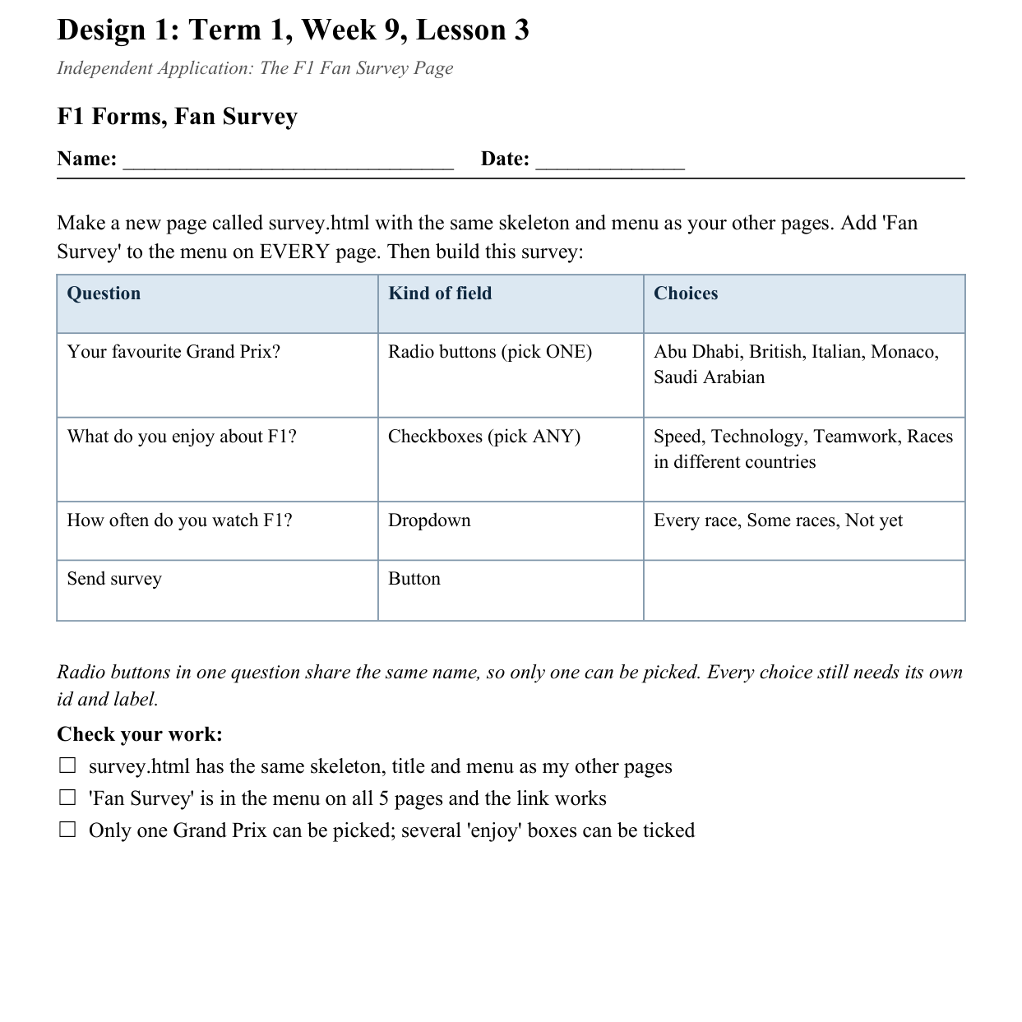
LESSON CORE
You Do: Build the Fan Survey
Create survey.html and add Fan Survey to the menu on every page.
Build the survey from your sheet.
Activity: F1 Forms, Fan Survey
Gradual Release of Responsibility
30 - 40 minutes
2 / 2

Slide 9
CLOSURE
Teacher Circulation
No formal exit ticket today. Teacher circulates for 1:1 support.
Transition & Extend
5 - 10 minutes

